Slide 1
E-Commerce BigData Project
Presented by :
Dejen T
Nishad P
Abraham O
11/11/2024

Slide 2
Introduction
This project explores the trends of sales across countries, product categories, locations and peak times.
Using Spark for data processing and Power BI for visualizations, we uncover insights that enhance strategic decision-making and improve overall sales performance.

Slide 3
Objectives
The objective of this analysis is to gain insights into sales patterns across different countries, product categories, locations, and times.
The analysis focuses on answering the following key questions:
Top-Selling category of items per country
Product popularity throughout the year per country
Locations with the highest sales traffic
Times with the highest traffic of sales per country

Slide 4
Data Generation
15,000 rows of data were generated using PySpark, Faker, and Python’s random library to create a realistic e-commerce dataset.
This dataset includes 1,000 failure transactions to simulate various sales data patterns.
It covers all the details given in the schema structure.
The generated data is saved as a csv file.

Slide 5
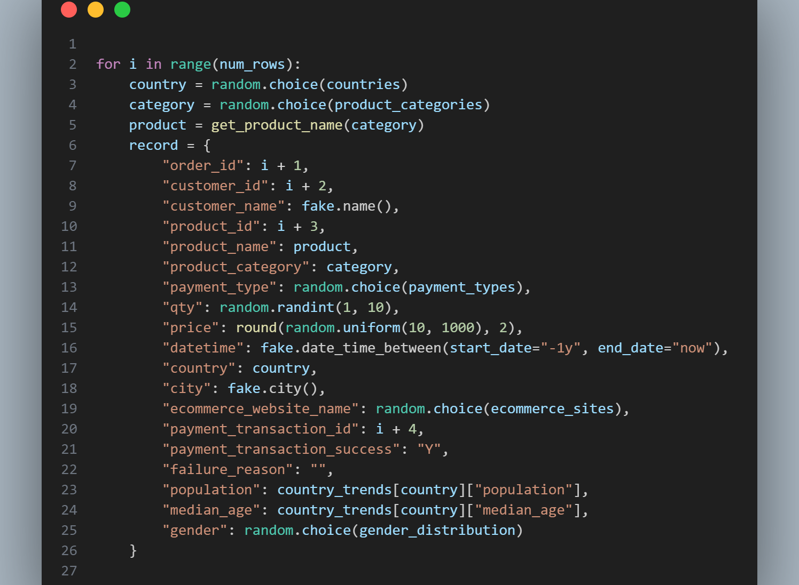
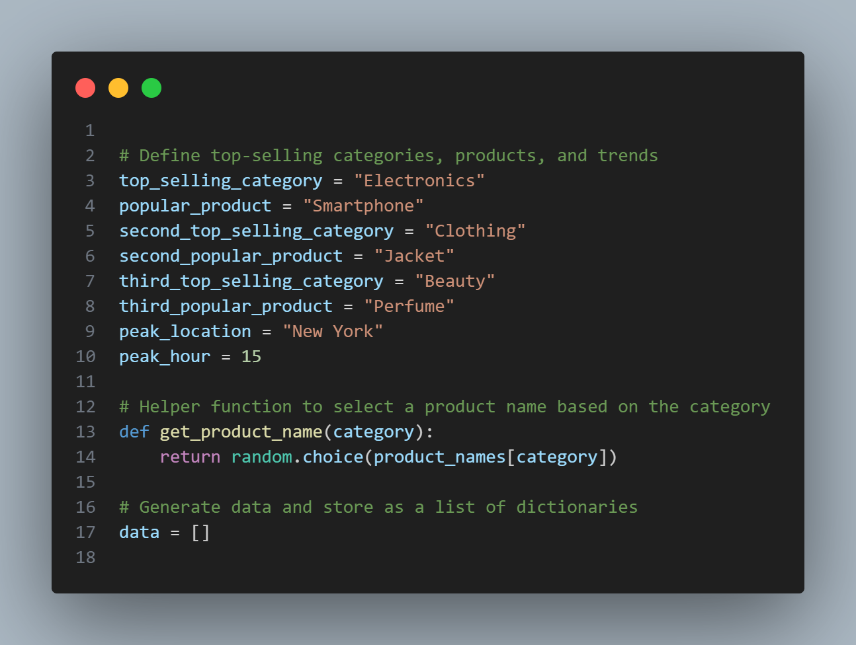
Data Generation Code

Slide 6
Rogue Data Generation
5% of the dataset, or approximately 750 rows, were intentionally modified to include rogue data.
These records contain invalid values across key fields, such as price, quantity, and country

Slide 7
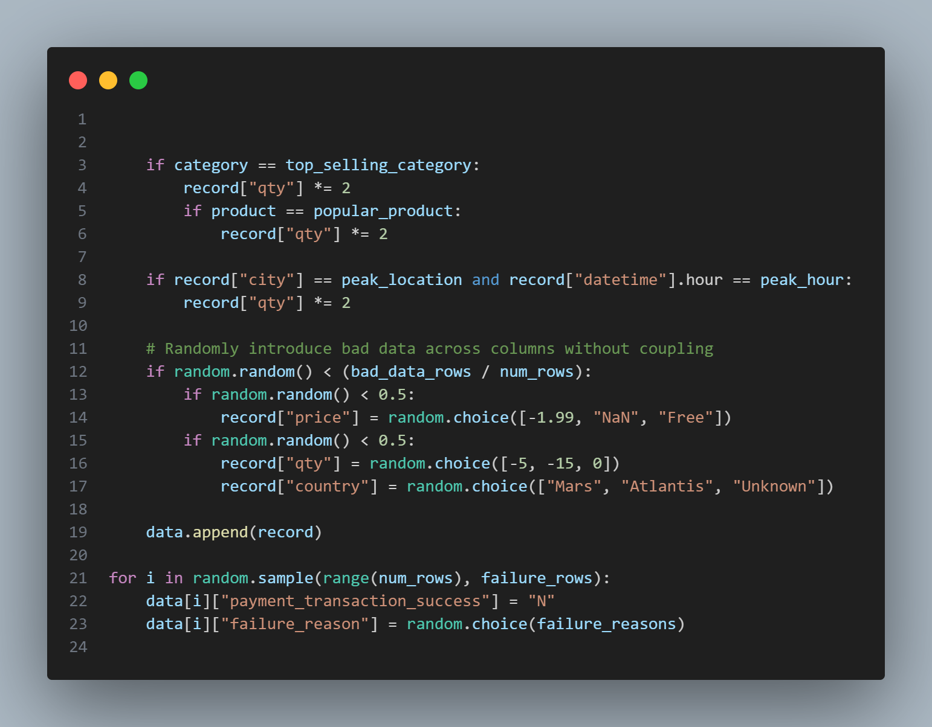

Slide 8
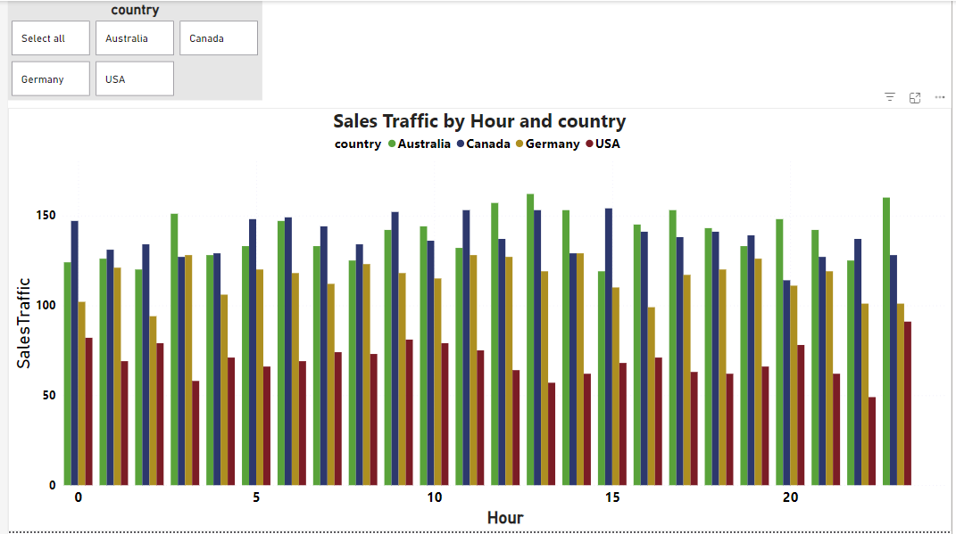
Notes:
This is a Power BI Visualization for Sales Traffic per hour and country.
It Counts number of rows or transactions per city, country and hour.
It is useful for analyzing traffic or transaction volume in different locations and times.

Slide 9
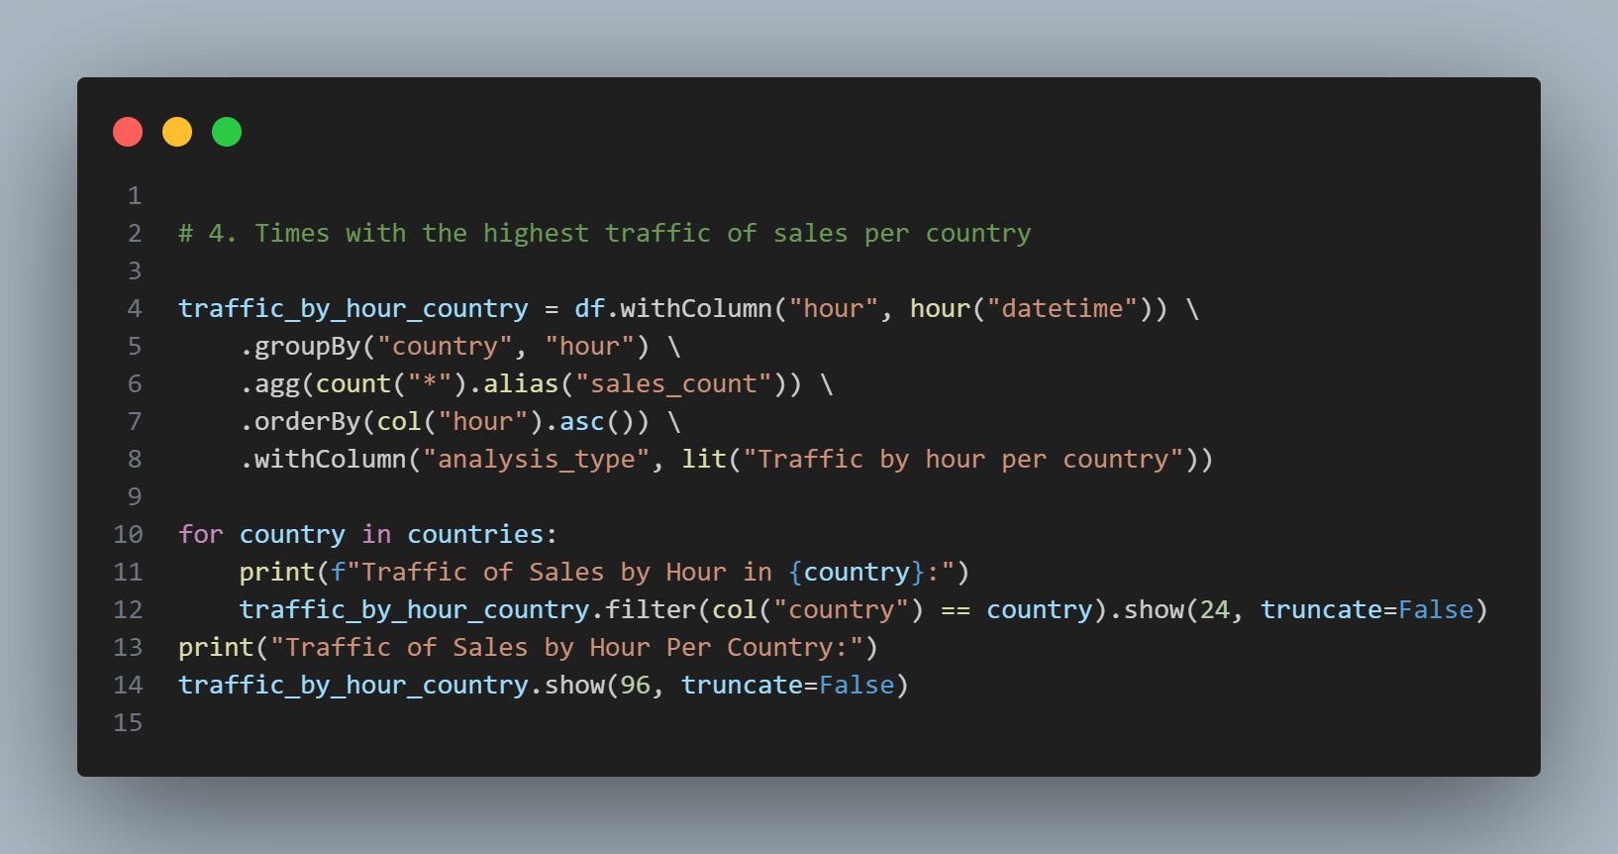
Spark code for traffic of sales

Slide 10
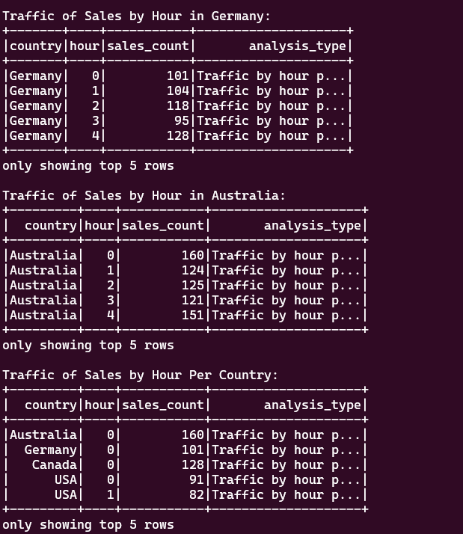

Slide 11
Analysis
4.What times have the highest traffic of sales? Per country?
This analysis identifies the peak sales hours for each country.
Australia:
Sales traffic picks at 13:00 with total sales traffic count of 160, followed by 14:00
with 153 sales. This suggests that mid-afternoon is high-demand period for Australia.
Canada:
The busiest hours in Canada are 14:00 and 15:00 with sales count 153 and 154 respectively. This indicates that early afternoon is the prime time for sales.
Germany:
Peak sales traffic occurs at 14:00 with 153 sales and 16:00 with 129 sales. Afternoon hours appear to be the most active for sales in Germany.
USA:
The USA sees the highest sales traffic at 0:00 (midnight) with 101 sales, followed by a steady decrease through the early morning hours. This unique trend suggests that late-night shopping is popular, potentially indicating demand from night-shift workers or a preference for late-night shopping online.

Slide 12
Data Processing and Cleaning
Used query on furniture_data to find null, invalid string, negatives, zero, and empty string values
Cleaned data by replacing fields using relationship between country-to-city and product_id-to-product_name

Slide 13
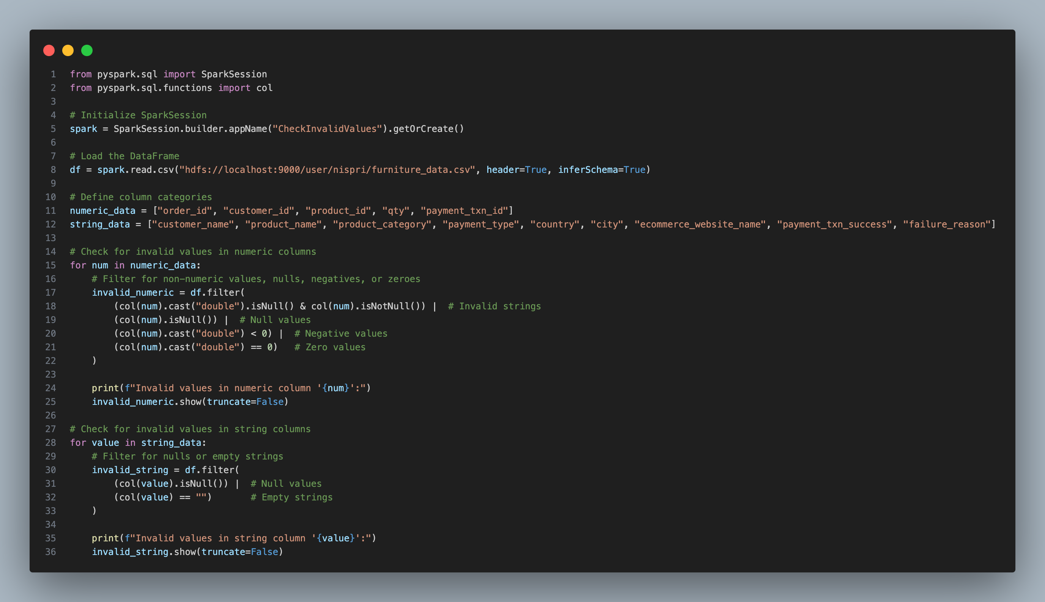
Data Processing

Slide 14
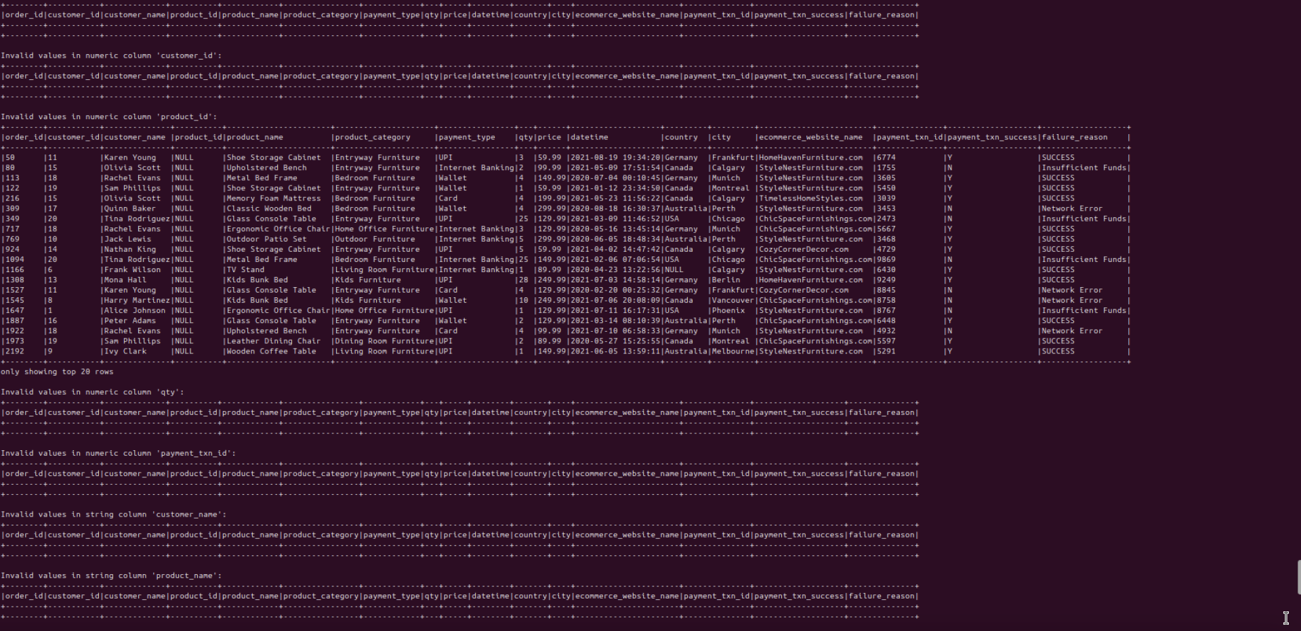

Slide 15
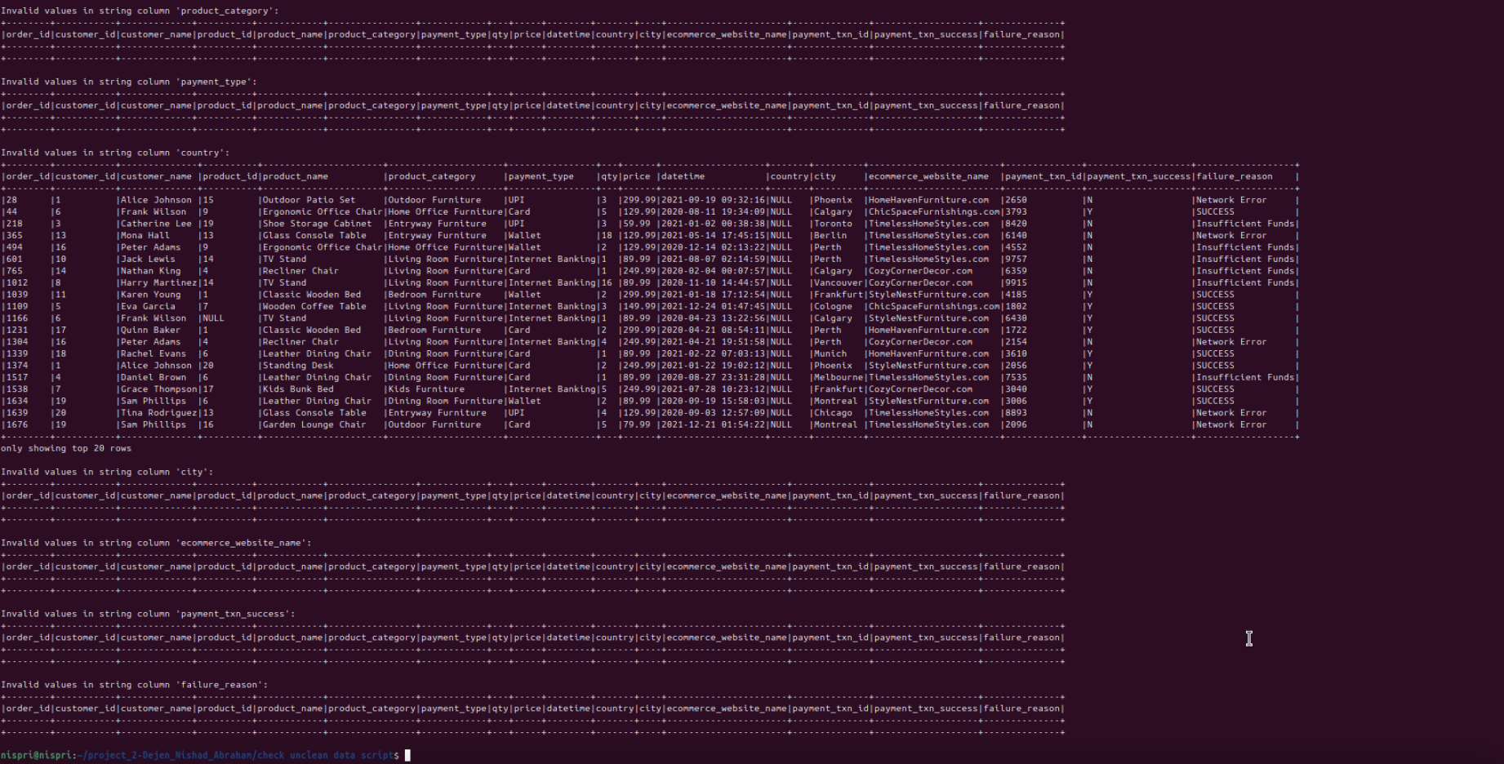

Slide 16
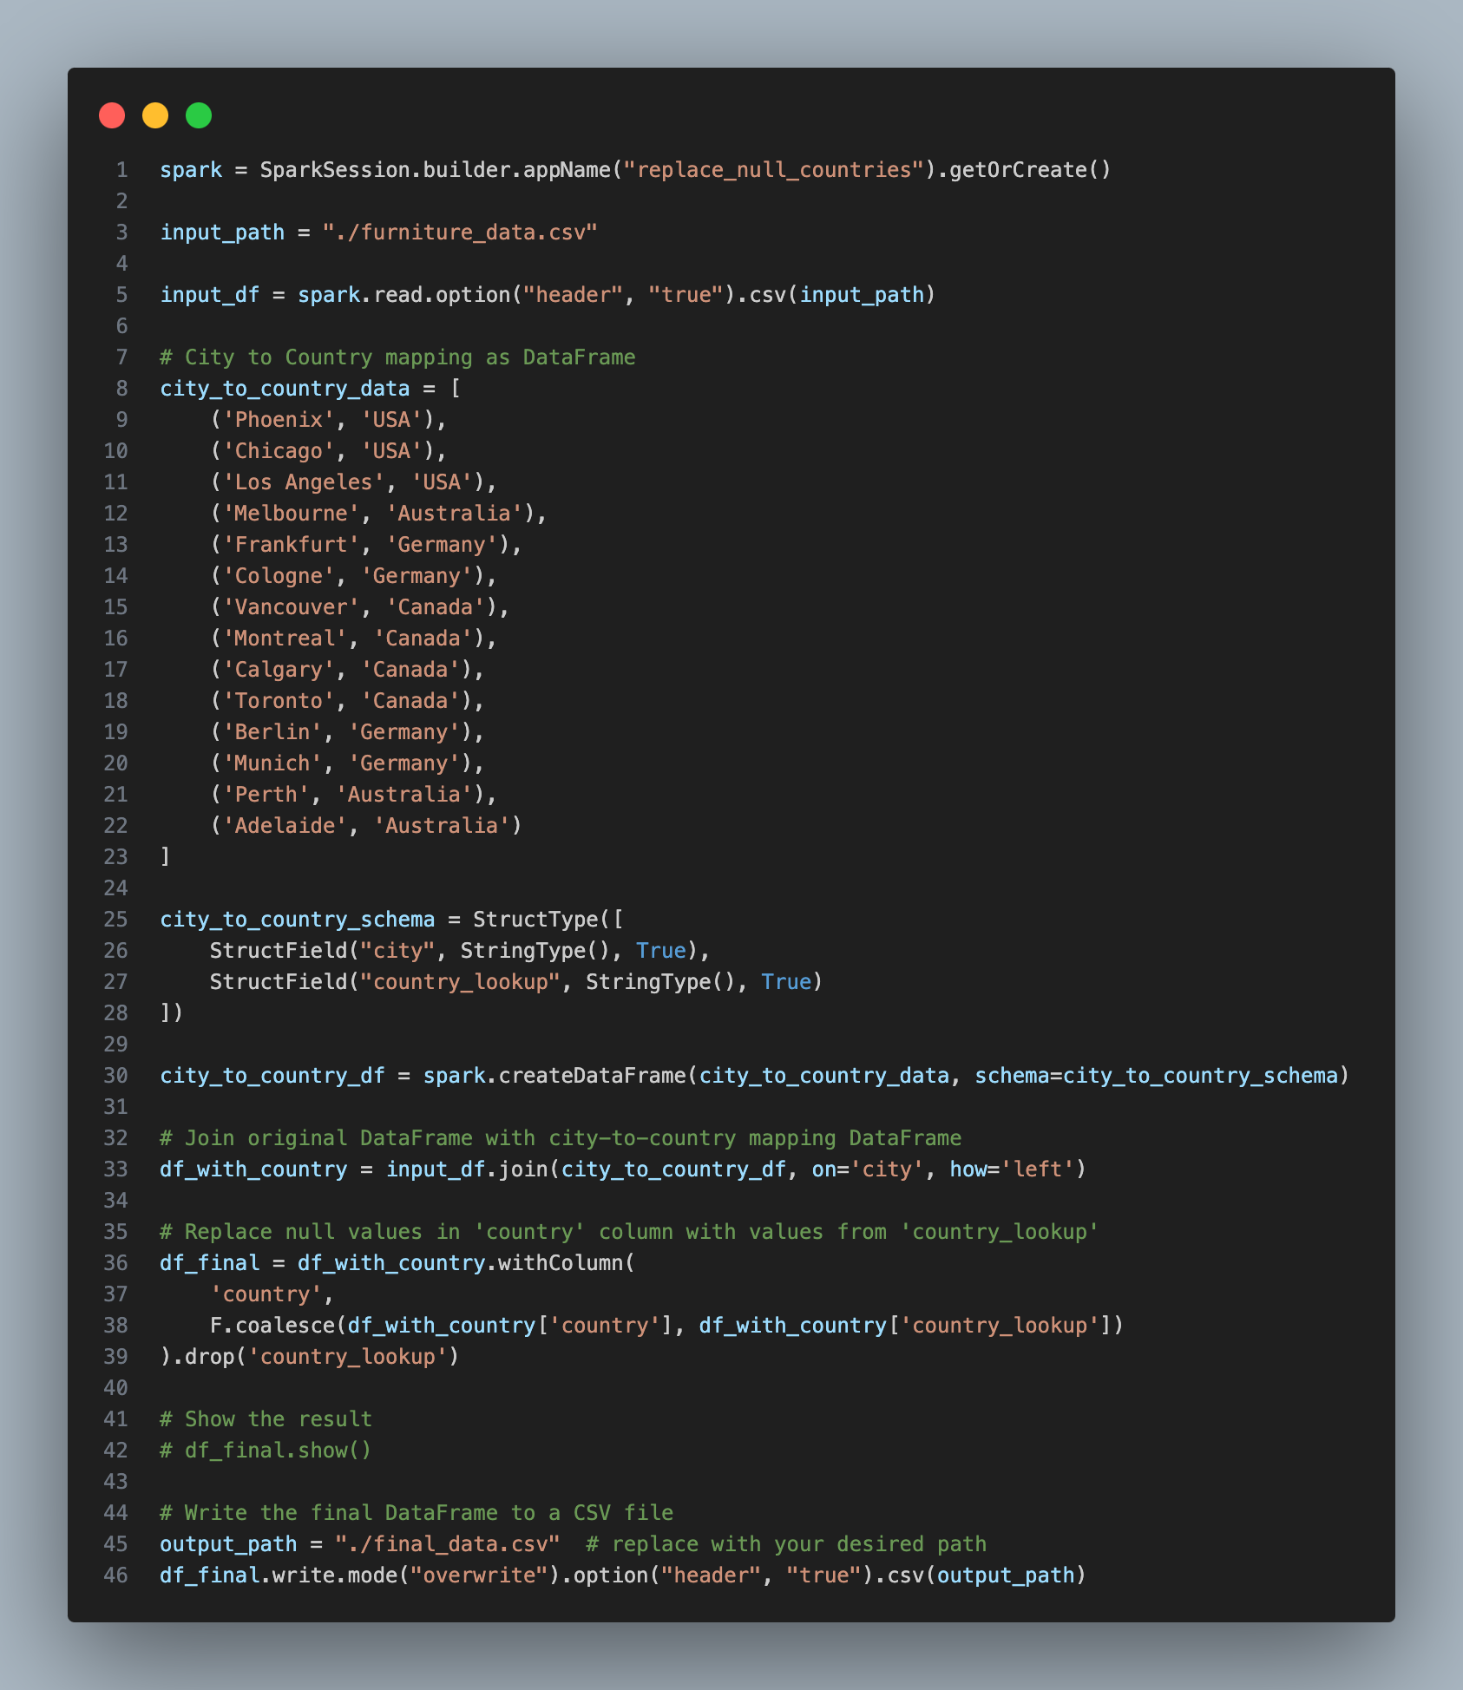
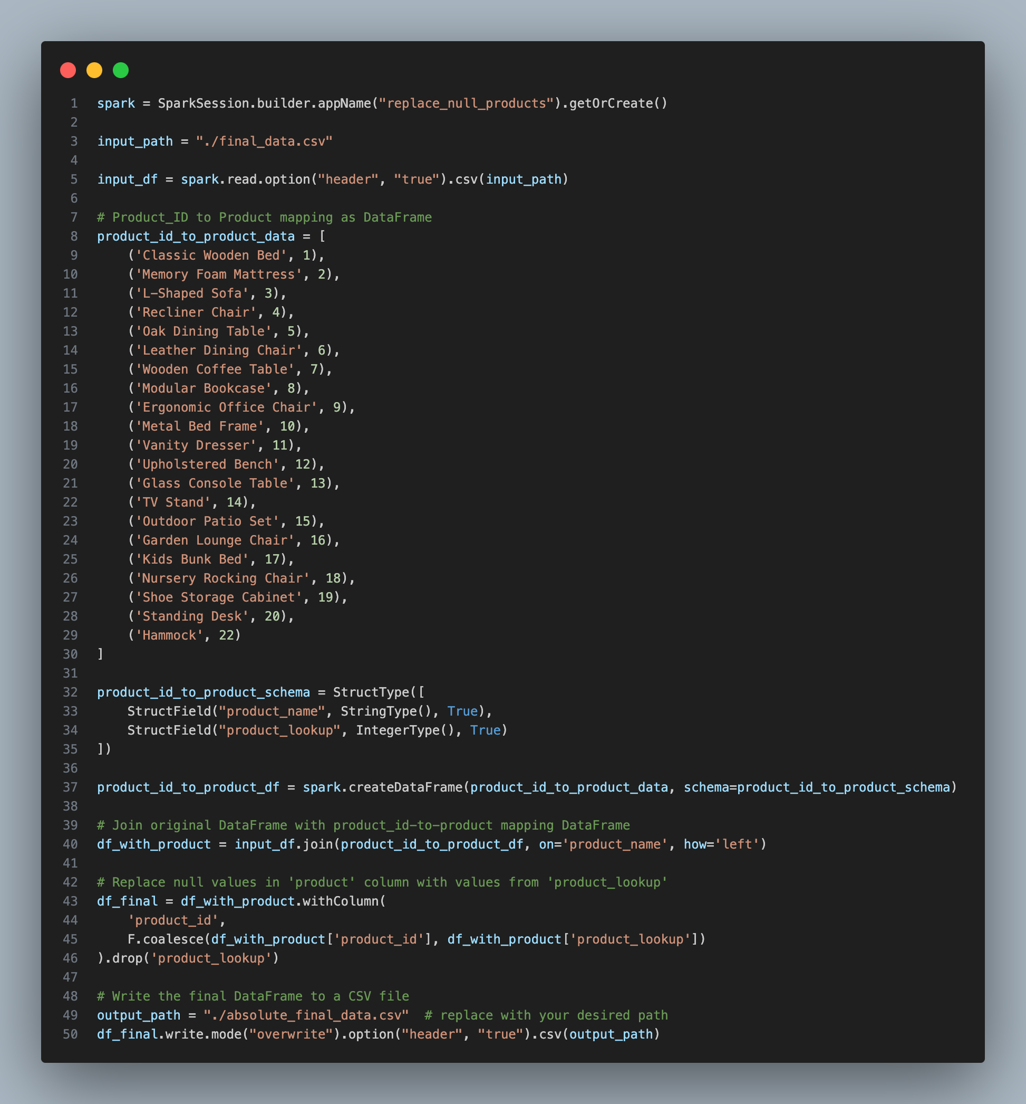
Data Cleaning

Slide 17
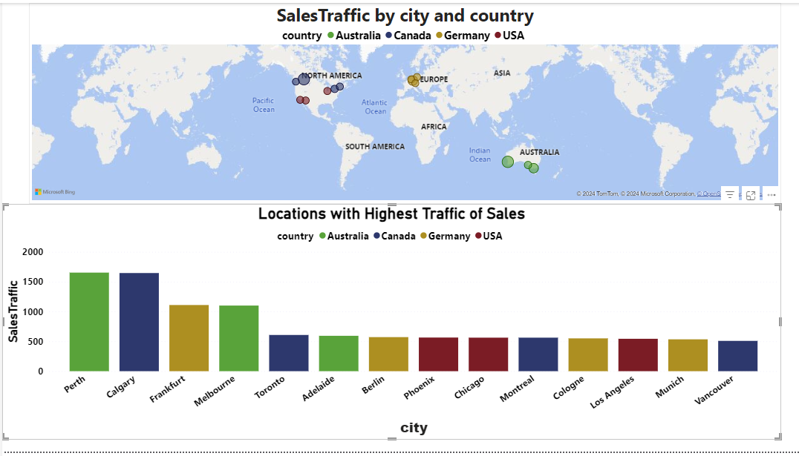

Slide 18
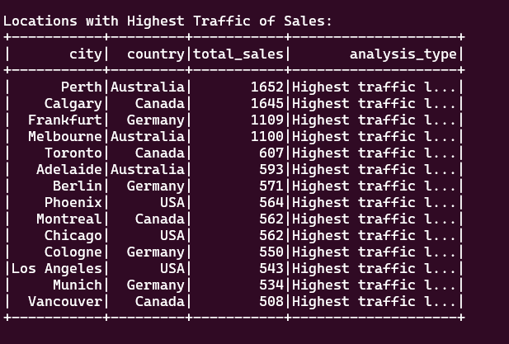

Slide 19
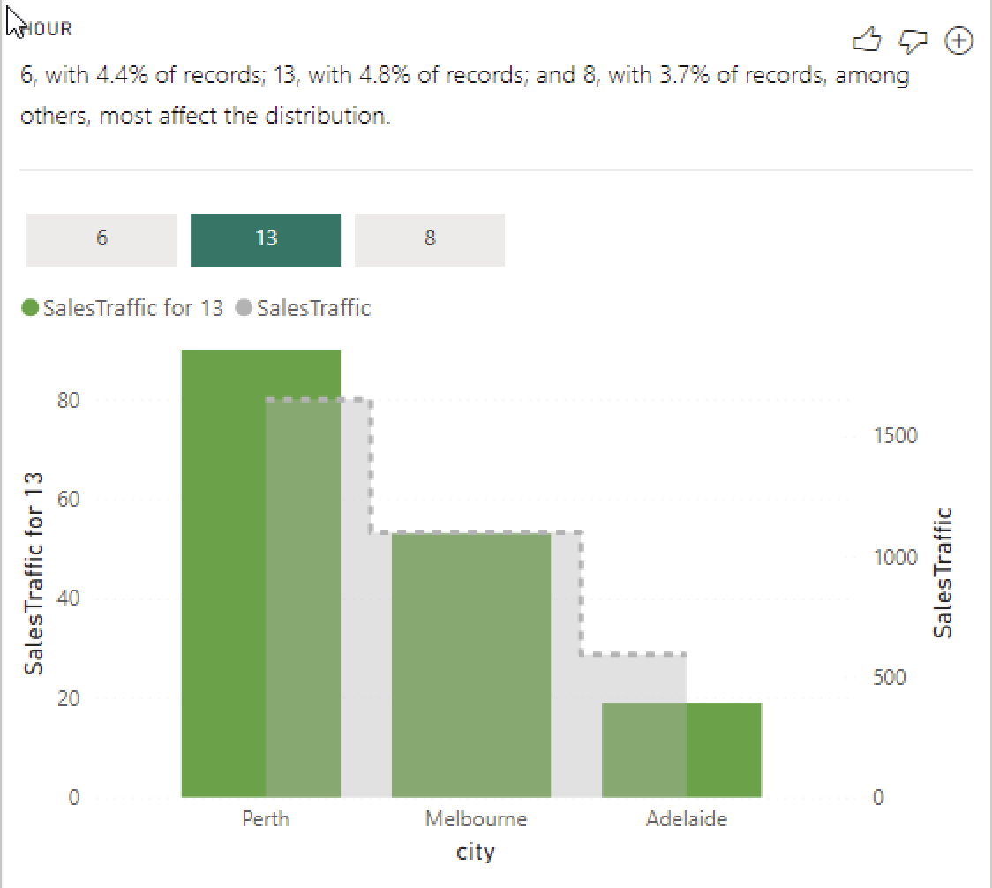
Analysis
3. Which locations see the highest traffic of sales.
Perth, Australia and Calgary, Canada are the top selling cities.
Canada, Australia and Germany are the only countries in the top 5 locations by sales traffic.
According to Analyze in Power BI, Perth is the highest seller in hours 6, 13, and 8 which contributes to it being the leader in sales.
Spark analysis confirms that the values of highest traffic align with the values of each cities’ records in the Power BI graph.

Slide 20
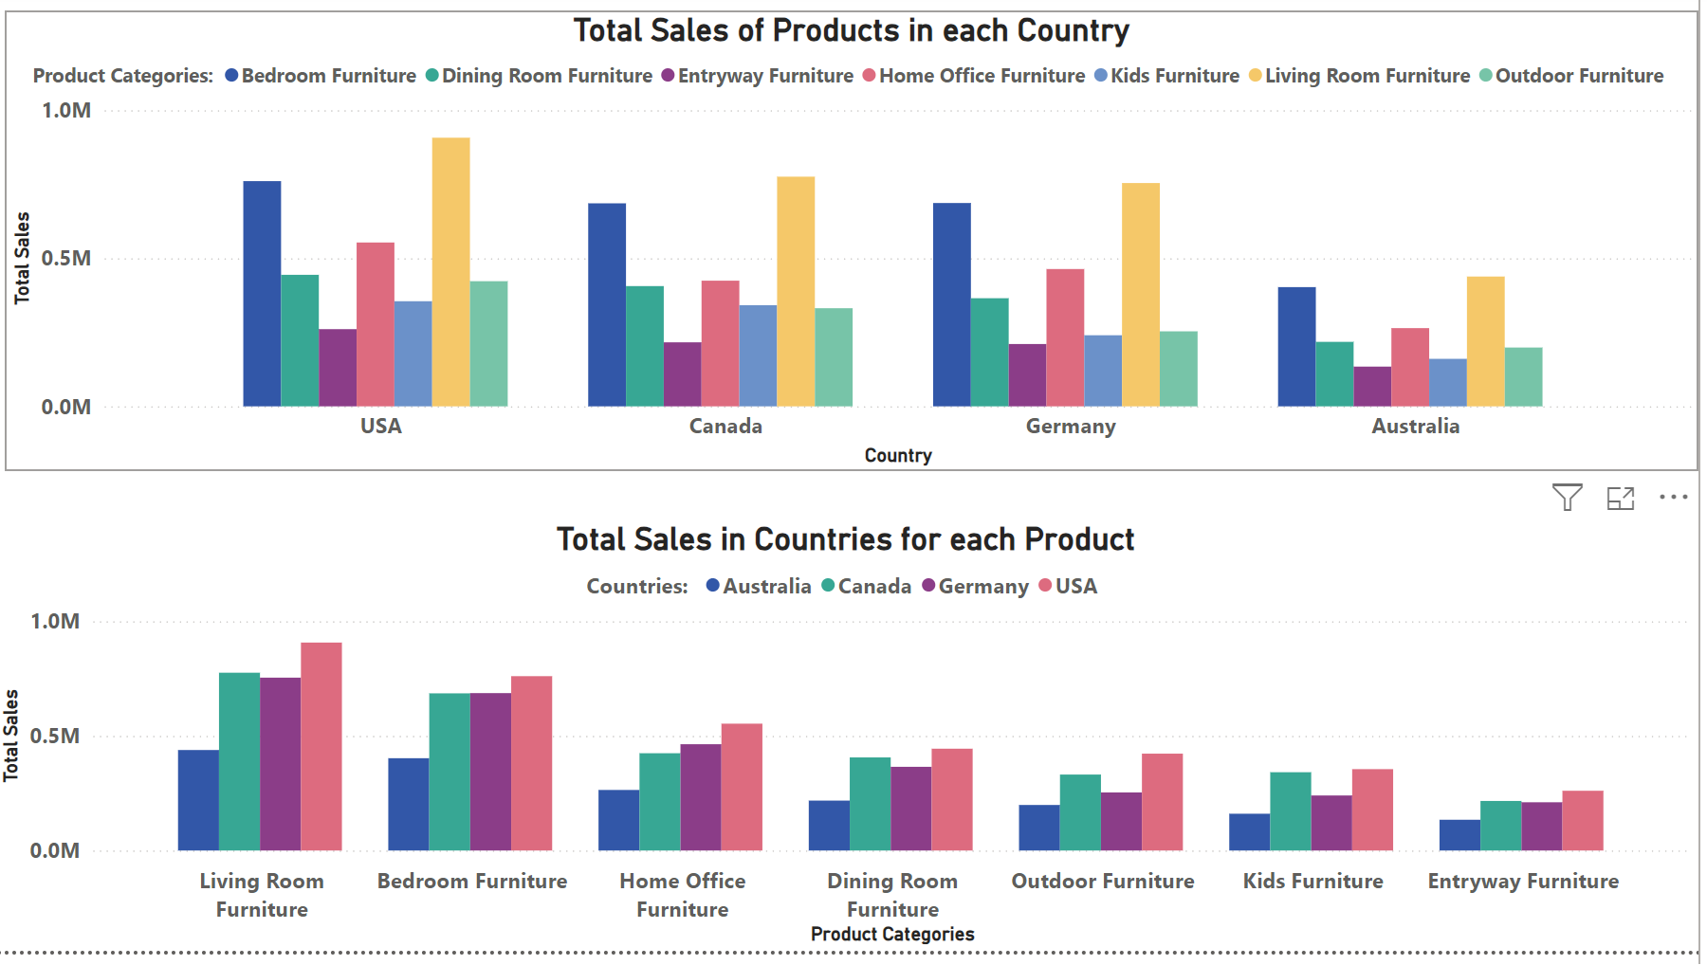
What is the top selling category of items, per country?

Slide 21
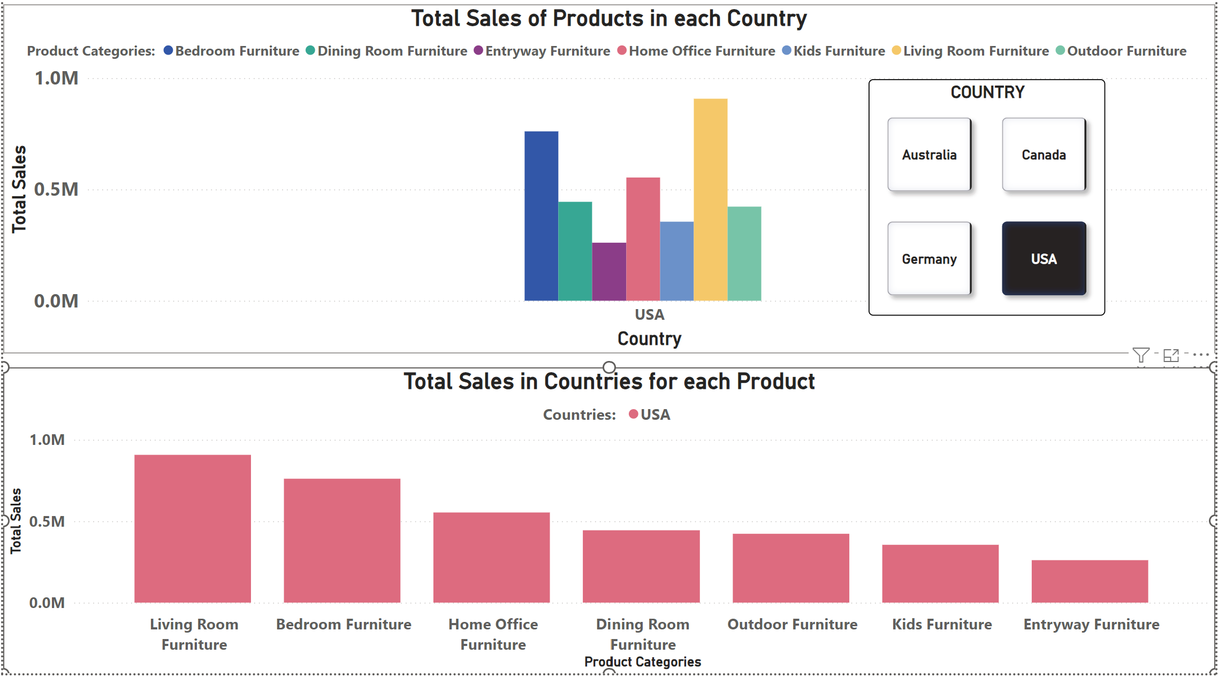

Slide 22
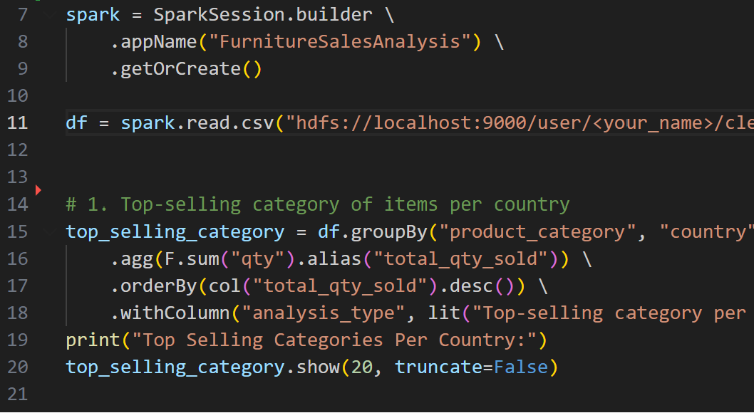

Slide 23
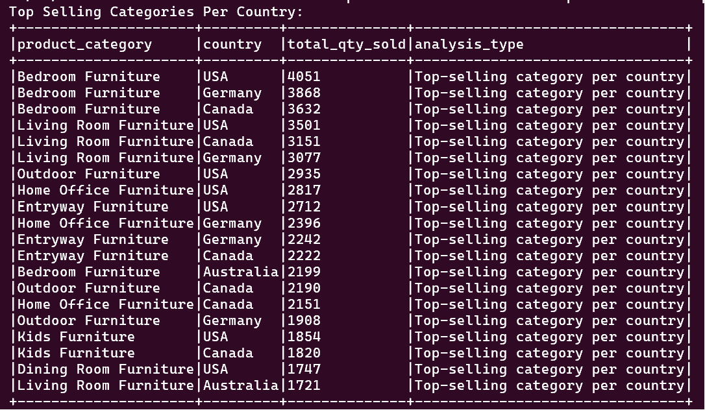

Slide 24
Analysis
With a total revenue of $907,374.99, the USA had the highest sales of products.
Australia generated the least revenue with a total sales of $438,502.79.
All countries had Living Room Furniture as the highest selling product category and Bedroom Furniture as the least selling product category.

Slide 25
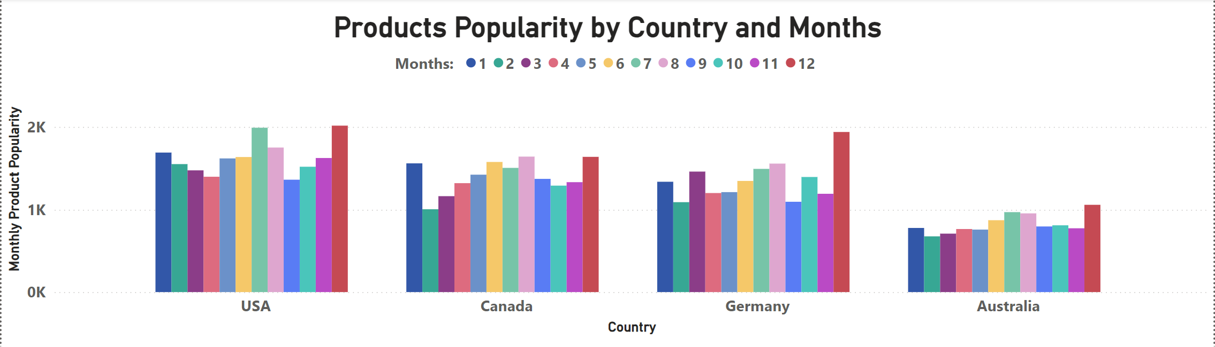
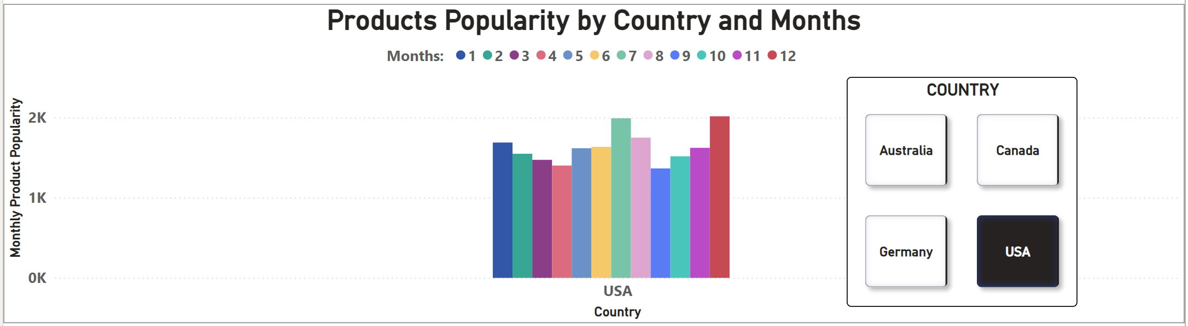
How does the popularity of products change throughout the year, per country?

Slide 26
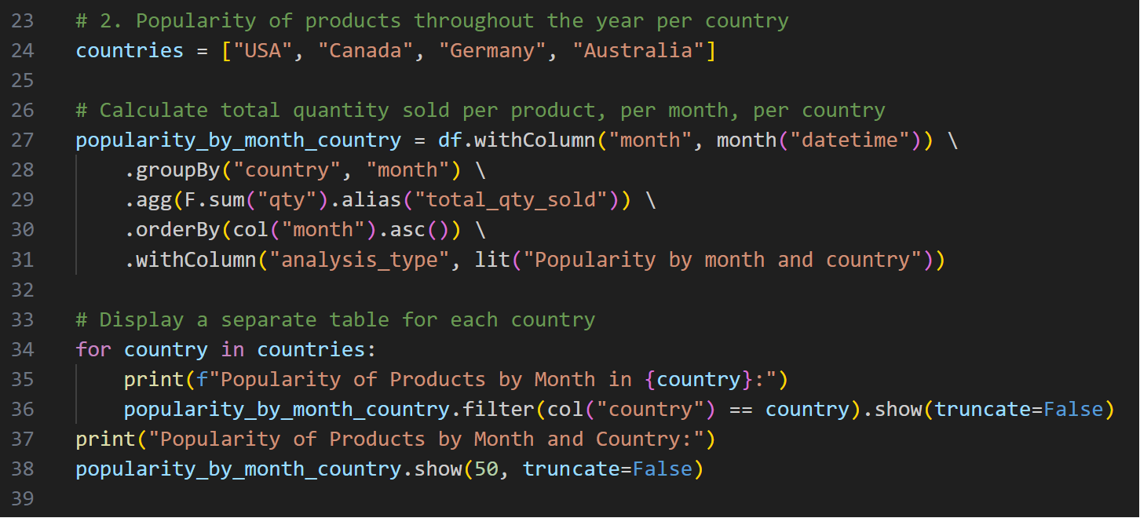

Slide 27
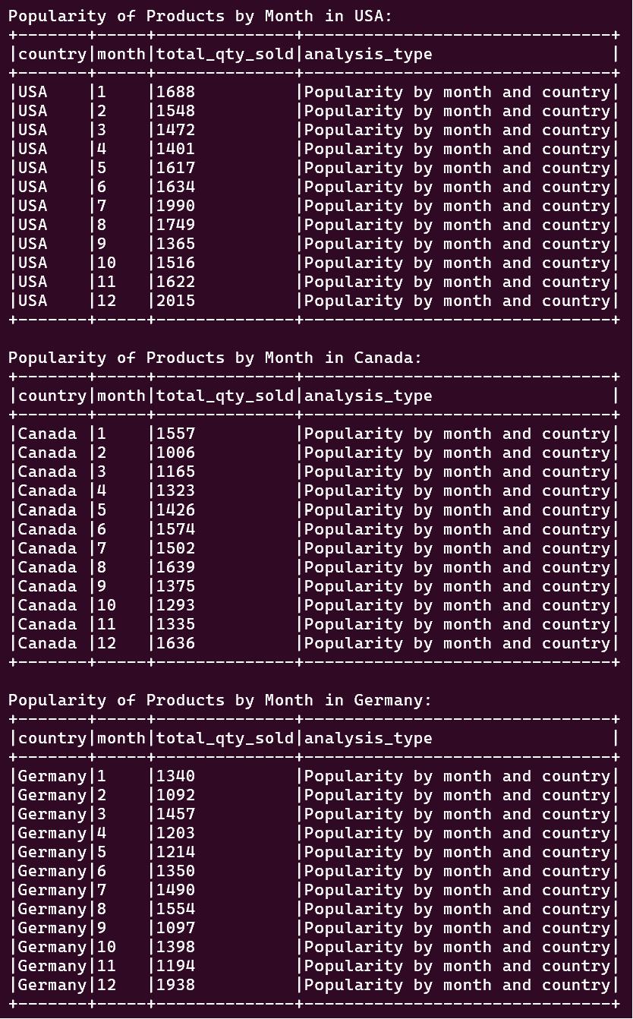
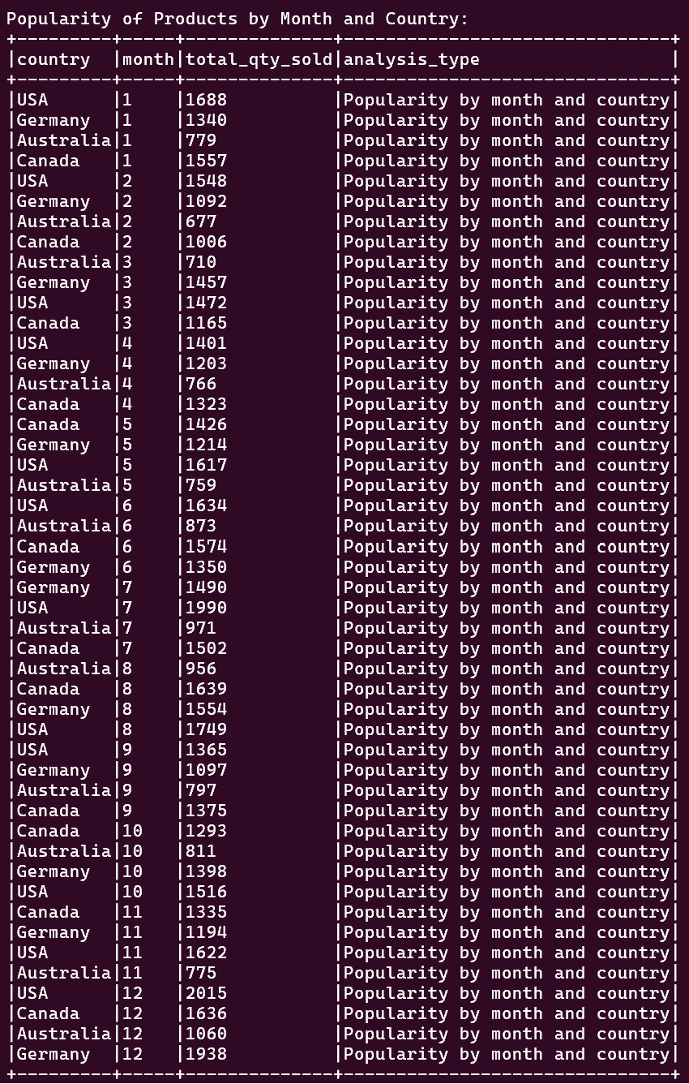

Slide 28
Analysis
The label was obtained from a measure named as Monthly Product Popularity, based on product name, country and month as features.
There were sinusoidal fluctuations in product popularity in all participating countries throughout the year.
Every country had the peak product popularity on the 12th month of the year.
Overall, the US had the highest product popularity of 2015 while Australia had the lowest product popularity of 677.

Slide 29


Slide 30
Thank you
Questions?

